Slide 1

Futurense
Democratizing Tech Talent to deliver impact at scale

Slide 2
Health Care Project Dataset:
HealthcareTables

Slide 3
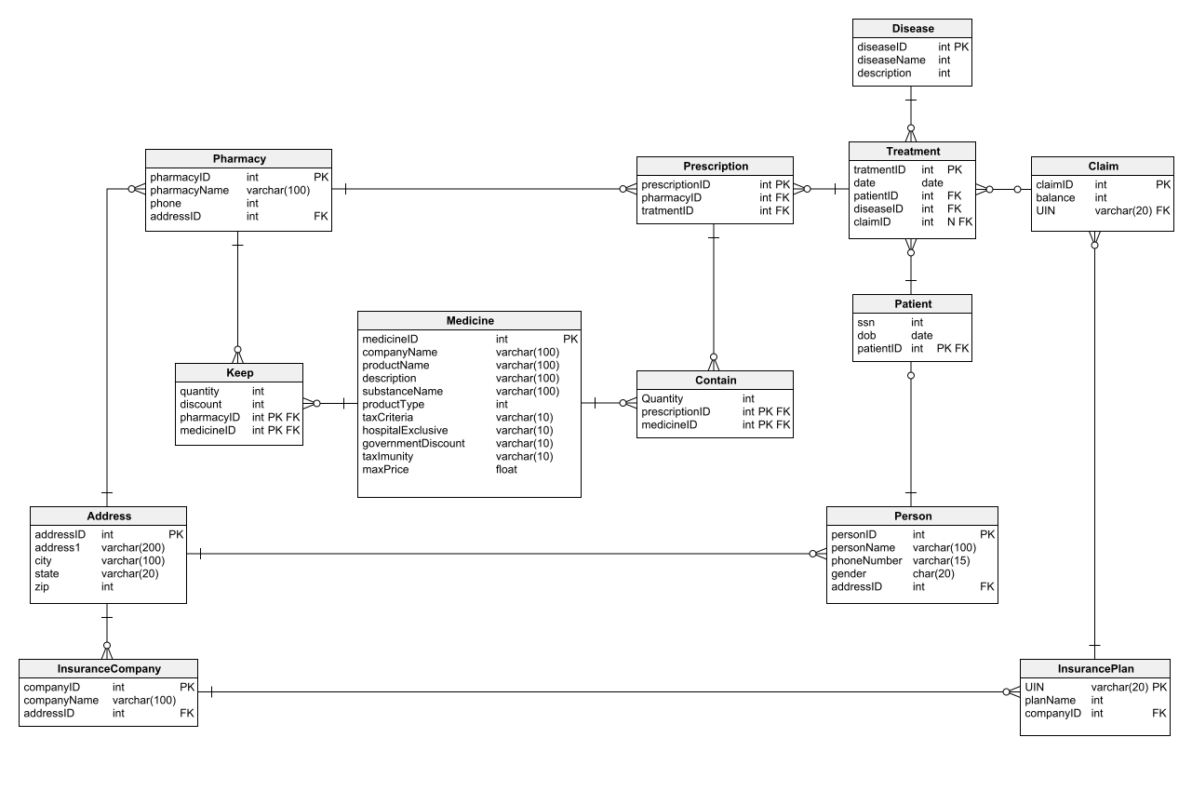

Slide 4
Problem Statement 11: Some complaints have been lodged by patients that they have been prescribed hospital-exclusive medicine that they can’t find elsewhere and facing problems due to that. Joshua, from the pharmacy management, wants to get a report of which pharmacies have prescribed hospital-exclusive medicines the most in the years 2021 and 2022. Assist Joshua to generate the report so that the pharmacies who prescribe hospital-exclusive medicine more often are advised to avoid such practice if possible. Problem Statement 12: Insurance companies want to assess the performance of their insurance plans. Generate a report that shows each insurance plan, the company that issues the plan, and the number of treatments the plan was claimed for.

Slide 5
Problem Statement 13: Insurance companies want to assess the performance of their insurance plans. Generate a report that shows each insurance company's name with their most and least claimed insurance plans. Problem Statement 14: The healthcare department wants a state-wise health report to assess which state requires more attention in the healthcare sector. Generate a report for them that shows the state name, number of registered people in the state, number of registered patients in the state, and the people-to-patient ratio. sort the data by people-to-patient ratio.

Slide 6
Problem Statement 15: Jhonny, from the finance department of Arizona(AZ), has requested a report that lists the total quantity of medicine each pharmacy in his state has prescribed that falls under Tax criteria I for treatments that took place in 2021. Assist Jhonny in generating the report.

